Slide 1
Weekcode
Week 7: The Substring Problem, The Twin Duplicates Problem, & The Binary Sum Problem

Slide 2
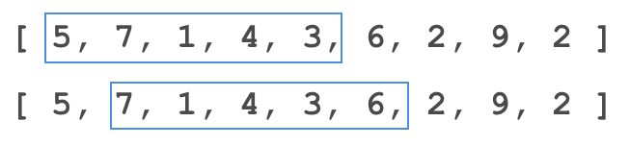
This week’s DSA concept:
Sliding Window

Slide 3
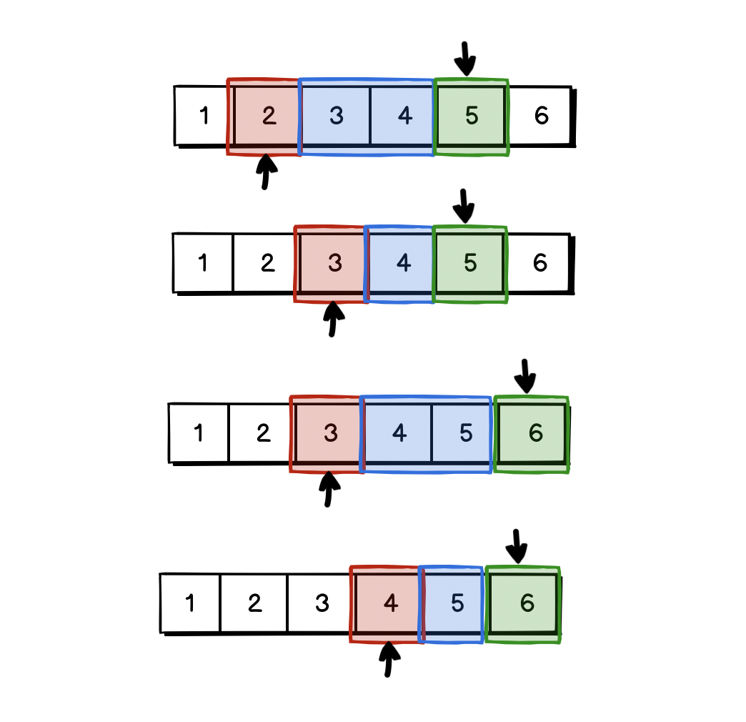
Sliding Window Technique
More of a technique than a pure Data Structure or Algorithm
Works in conjunction with other techniques, like 2 pointer

Slide 4
Sliding Window Explained
A “Sliding Window” is a range of consideration to solve some problem
The size of the window does not have to be static per iteration
Commonly used to supplement nested loop O(n^2) algorithms to make them O(n) or single-pass

Slide 5
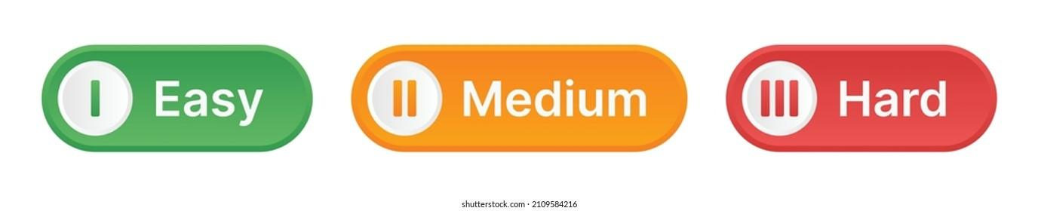
Weekcode Challenge #12:
The Substring Problem
A string is good if there are no repeated characters. Given a string s​​​​​, return the number of good substrings of length three in s​​​​​​. Note that if there are multiple occurrences of the same substring, every occurrence should be counted. A substring is a contiguous sequence of characters in a string.
Input: s = "xyzzaz"
Output: 1
Explanation: There are 4 substrings of size 3: "xyz", "yzz", "zza", and "zaz".
The only good substring of length 3 is "xyz".

Slide 6
Weekcode Challenge #12:
The Substring Problem
[EXPLAINED FURTHER]
Input: s = "aababcabc"
Output: 4
Explanation: There are 7 substrings of size 3: "aab", "aba", "bab", "abc", "bca", "cab", and "abc".
The good substrings are "abc", "bca", "cab", and "abc".

Slide 7
Weekcode Challenge #13:
The Twin Duplicates Problem
Given an integer array nums and an integer k, return true if there are two distinct indices i and j in the array such that
nums[i] == nums[j] and abs(i - j) <= k.
Input: nums = [1,0,1,1]
k = 1
Output: true
Input: nums = [1,2,3,1]
k = 3
Output: true
Input: nums = [1,2,3,1,2,3]
k = 2
Output: false

Slide 8
Weekcode Challenge #14:
The Binary Sum Problem
Given a binary array nums and an integer goal, return the number of non-empty subarrays with a sum goal. A subarray is a contiguous part of the array.
Input: nums = [1,0,1,0,1], goal = 2
Output: 4
Explanation: The 4 subarrays are bolded and underlined below:
[1,0,1,0,1]
[1,0,1,0,1]
[1,0,1,0,1]
[1,0,1,0,1]
= 1 + 0 + 1 = 2 = goal
= 1 + 0 + 1 + 0 = 2 = goal
= 0 + 1 + 0 + 1 = 2 = goal
= 1 + 0 + 1 = 2 = goal

Slide 9
Weekcode Challenge #14:
The Binary Sum Problem
[EXPLAINED FURTHER]
[0,0,0,0,0]
[0,0,0,0,0]
[0,0,0,0,0]
[0,0,0,0,0]
[0,0,0,0,0]
[0,0,0,0,0]
[0,0,0,0,0]
[0,0,0,0,0]
[0,0,0,0,0]
[0,0,0,0,0]
[0,0,0,0,0]
[0,0,0,0,0]
[0,0,0,0,0]
[0,0,0,0,0]
[0,0,0,0,0]
Input: nums = [0,0,0,0,0]
goal = 0
Output: 15
Explanation: Subarrays can be just 1 element long, or as long as the entire list, as long as it sums to goal. There are
15 unique permutations to sum 0 from
[0,0,0,0,0], shown to the right:

Slide 10
Looking Ahead
Good Luck! Midterm break next week!
Hackathon is on March 16th this Saturday!
Make sure you get boilerplate/example code from the GitHub!

